Slide 1
Planning for a successful Kindergarten Readiness Snapshot that engages families
Getting ready – visit agesandstages.com/ks and download the “Review and Next Steps Planning Tool” under “Initiative Resources” at the bottom of the page.

Slide 2
The vision: Kansas leads the world in the success of each student.

Slide 3

A child’s earliest years are an incredible opportunity to support later success.
More than 90% of a child’s brain architecture develops by age five.
Families are children’s first and most important teachers.
Strong relationships between families and teachers lay the foundation for a successful school year.

Slide 4
This session will be a success if…
You are confident in creating a Kindergarten Readiness Snapshot plan for next school year that will include sharing ASQ results with families.

Slide 5
Resources
agesandstages.com/ks – Resources to Support Implementation
Kindergarten Readiness Snapshot Fact Sheet
“Initiative Resources” – Review and Next Steps Planning Tool
KSDE Web Applications – Kindergarten Readiness Snapshot
asqonline.com – ASQ Online System

Slide 6
The Research Case for Investing in the Transition to Kindergarten
Kindergarten teachers report that almost 50% of children have difficulty adjusting to kindergarten.¹
Many communities do not have transition to kindergarten plans, and those that do often focus on low-intensity, more superficial activities.²
The more transition activities prekindergarten teachers implement, the better prepared children are at the beginning of kindergarten.³
The more transition activities kindergarten teachers implement, the higher student achievement by the end of kindergarten.⁴
Transition benefits are strongest for children in low- and middle-income families.^{5, 6, 7, 8}
From the Alabama Transition to Kindergarten Toolkit, page 10.
Notes:
1 Sara E. Rimm-Kaufman, Robert C. Pianta, and Martha J. Cox, “Teachers’ judgments of problems in the transition to kindergarten,” Early Childhood Research Quarterly 15, no. 2 (2000), https://doi.org/10.1016/S0885-2006(00)00049-1, https://www.sciencedirect.com/science/article/abs/pii/S0885200600000491?via%3Dihub.
2 Michael H. Little, Lora Cohen-Vogel, and F. Chris Curran, “Facilitating the Transition to Kindergarten,” AERA Open 2, no. 3 (2016), https://doi.org/10.1177/2332858416655766
3 Jennifer LoCasale-Crouch et al., “Pre-kindergarten teachers’ use of transition practices and children’s adjustment to kindergarten,” Early Childhood Research Quarterly 23, no. 1 (2007), https://doi.org/10.1016/j.ecresq.2007.06.001.
4 Amy B. Schulting, Patrick S. Malone, and Kenneth A. Dodge, “The Effect of School-Based Kindergarten Transition Policies and Practices on Child Academic Outcomes,” Developmental Psychology 41, no. 6 (2005), https://pmc.ncbi.nlm.nih.gov/articles/PMC2757260/
5 Annarilla Ahtola et al., “Transition to formal schooling: Do transition practices matter for academic performance?,” Early Childhood Research Quarterly 26, no. 3 (2011/07/01/ 2011), https://www.sciencedirect.com/science/article/
pii/S088520061000092X; Carey E. Cooper and Robert Crosnoe, “The Engagement in Schooling of Economically Disadvantaged Parents and Children,” Youth & Society 38, no. 3 (2007), https://journals.sagepub.com/doi/abs/10.1177/0044118X06289999; Jennifer LoCasale-Crouch et al., “Prekindergarten teachers’ use of transition practices and children’s adjustment to kindergarten,” Early Childhood Research Quarterly 23 (03/01 2008), https://doi.org/10.1016/j.ecresq.2007.06.001, https://www.sciencedirect.com/science/article/abs/pii/S0885200607000403?via%3Dihub; Schulting, Malone, and Dodge, “The Effect of School Based Kindergarten Transition Policies and Practices on Child Academic Outcomes.”

Slide 7
Transition activities lead to improved student outcomes.
“Using a large, nationally representative sample…we found that kindergarten transition policies do indeed have a modest positive effect on students’ academic achievement and on parent-initiated school involvement during the kindergarten year…This finding provides the strongest empirical support to date for school policies designed to facilitate the transition to kindergarten.”
Schulting, Malone, and Dodge, “The Effect of School-Based Kindergarten Transition Policies and Practices on Child Academic Outcomes,” Developmental Psychology 41, no. 6 (2005)
Notes:
Information regarding transition polices and practices was reported by kindergarten teachers in the fall of 1998. kindergarten teachers were asked to identify which of the following seven transition practices were implemented at their school to ease children’s transition to kindergarten: (a) information about the kindergarten program is phoned or sent home to parents, (b) preschoolers spend time in the kindergarten classrooms, (c) school days are shortened at the beginning of the school year, (d) parents and children visit kindergarten prior to the start of the school year, (e) teachers visit students’ homes at the beginning of the school year, (f) parents attend an orientation session prior to the school year, or (g) other transition activities are provided. We computed a score for each teacher by totaling the number of transition practices that were endorsed. Cronbach’s alpha coefficients indicated moderate internal consistency on this index (α = .44). This level of internal consistency is adequate for an index of this kind because implementation of all seven transition practices by one teacher is unlikely. Teachers were reporting transition practices primarily implemented at the school level; therefore, it was necessary to designate school transition scores as a school-level rather than a teacher-specific variable. Transition scores for each school were computed by averaging teacher-reported transition scores across all teachers at a particular school. For schools for which two or more teachers reported scores, the intraclass correlation was .93.

Slide 8
These benefits are strongest for students with low or moderate incomes.
“The effect of transition practices on academic achievement was stronger for children from average- or low-income families than for children from more affluent backgrounds…the predicted achievement scores of average- and low-income children receiving transition practices were substantially higher than they would have been had they attended schools that did not offer such practices. This finding is especially noteworthy in light of the finding that low-income children receive the fewest transition practices.”
Schulting, Malone, and Dodge, “The Effect of School-Based Kindergarten Transition Policies and Practices on Child Academic Outcomes,” Developmental Psychology 41, no. 6 (2005)

Slide 9
Transition activities increase parent-initiated school involvement.
“Kindergarten transition practices were found to have a positive effect on parent-initiated school involvement… The link between parent involvement and improved school outcomes is well established… schools’ effort to increase parent-initiated school involvement will have a positive impact on student academic outcomes. It is possible that transition practices help parents feel more comfortable at school, better informed of school activities, and aware of the importance of their involvement, which leads to increased parent-initiated school involvement and in turn to improved student achievement.”
Schulting, Malone, and Dodge, “The Effect of School-Based Kindergarten Transition Policies and Practices on Child Academic Outcomes,” Developmental Psychology 41, no. 6 (2005)
Notes:
In contrast, teacher-initiated parent involvement, as reported by teachers, was negatively associated with child outcomes… It is possible that teachers attempt to involve parents at school and encourage them to attend meetings and conferences about their child’s progress primarily after the child has displayed problems in school.

Slide 10
Pair and share: What strategy do you think is most impactful when it comes to preparing students, families, staff, and partners for kindergarten in your schools?

Slide 11
Let’s learn how to:
Access and reflect on 2025-2026 data
Support staff in partnering with families
Plan for a successful Kindergarten Readiness Snapshot

Slide 12
Access and Reflect on 2025-2026 Kindergarten Readiness Snapshot Data

Slide 13
Accessing 2025-2026 Kindergarten Readiness Snapshot Data
Why is it important to review data?
Better information can inform better instruction – if we use it.
Open and save the “Review and Next Steps Planning Tool” posted at agesandstages.com/ks under “Initiative Resources”
Log in to KSDE Web Applications and navigate to the “Kindergarten Readiness Snapshot” application.
Notes:
More than 26,000 Kansas families of incoming kindergarten students took the time to complete the ASQ this school year. That is 26,000 opportunities for educators to have a thoughtful, personalized conversation about an incoming kindergarten student’s strengths and needs.

Slide 14
Matching Unmatched ASQ Students
See the “Home” tab of the authenticated application for more information about how data is matched, and how to improve the quality of ASQ Online data.
School districts can use the authenticated application to match any unmatched students.
Click the “ASQ – Students” tab on the left and select “Unmatched ASQ Students” to see those ASQ records that were not initially matched to a student enrollment record.
Enter the State Student Identifier (SSID/KIDS ID) in the “Actual SSID” field and click the “Match” button to match those student records. This manual matching process runs nightly.

Slide 15
“Review and Next Steps” Planning Tool – Reviewing Participation
2025-2026 Kindergarten Readiness Snapshot (ASQ) Participation Rate Data
Total Enrolled in Kindergarten (Sept. 22 ENRL) | 32,538
Total Reason for Not Participating: Determined Screening Was Inappropriate | 121
Total Reason for Not Participating: Child older than age cutoff (77 months 30 days) | 11
Total Reason for Not Participating: Parent/Caregiver Opted Out of Participating – Included in calculation | 158
Total Screened ASQ-3 | 25,593
Total Screened ASQ:SE-2 | 24,625
Total Screened Both ASQ-3 and ASQ:SE-2 | 24,136
Participation Rate (Screening Percent) | 74.44%
Preliminary statewide data as of November 4, 2025
Notes:
ASQ-3 Only - 1,457
ASQ:SE-2 Only – 489
Altogether – more than 26,000 participated in at least one – 80% of Kansas kindergarten students

Slide 16
Digging deeper: As you look at your district’s participation data, what are you interested in exploring further?
Notes:
For example – I would be curious if there are big differences in participation rates at either the classroom level (for smaller districts) or the building level (for districts with more than one building)

Slide 17
ASQ-3 and ASQ:SE-2 Results, Kindergarten Readiness Snapshot 2025-26 Preliminary statewide data as of Nov. 20, 2025

Slide 18
Planning to lead a reflection activity
Lead with the “why”.
The “Snapshot Results PowerPoint Template” posted at agesandstages.com/ks under “Initiative Resources” includes talking points.
Consider both participation and results.
See the “Review and Next Steps Document” posted at agesandstages.com/ks under “Initiative Resources”.
Take two minutes to think and write: How will you support your staff in reviewing and reflecting on this year’s Snapshot data?

Slide 19
ASQ-3 and ASQ:SE-2 Results, Kindergarten Readiness Snapshot 2024-25

Slide 20
ASQ-3 and ASQ:SE-2 Results, Kindergarten Readiness Snapshot 2023-24

Slide 21
Support Staff in Partnering with Families

Slide 22
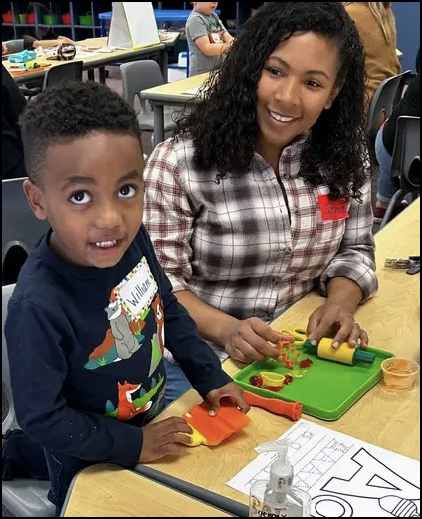
Parents as Teachers would be a terrific resource in building staff capacity to engage with families.
Parents as Teachers programs deliver:
Personal visits
Group learning and socializing events
Child and caregiver screenings
Connections to community resources
A strong body of research demonstrates that Parents as Teachers is an evidence-based model to promote family engagement and student success.
Click here for the directory of Kansas Parents as Teachers programs.
Contact Lisa Williams (Lisa.Williams@ksde.gov) to learn more about Parents as Teachers.

Slide 23
Why partner with families to complete the ASQ?
Parents are the expert on their child.
The Kindergarten Readiness Snapshot is a system to connect with each family.
Sharing ASQ results with families demonstrates that the school values their time and knowledge.
Listening and discussing results validates parents and builds trust.
Asking clarifying questions gives the school a chance to learn more about the child and the family.

Slide 24
Resources to support family engagement using the ASQ
Review the Kansas Kindergarten Readiness Snapshot Fact Sheet, posted at agesandstages.com/ks.
Tips for introducing ASQ to Parents and Caregivers
Tips for Partnering and Sharing ASQ Results with Families
Tips for Building Developmental Skills
Consider: How could you support your staff in reviewing these resources to identify what you can use moving forward?

Slide 25
Let’s discuss: What strategies have you found to be effective in supporting staff in partnering with families?

Slide 26
Plan for a Successful Kindergarten Readiness Snapshot

Slide 27
Making a plan for success
The Kindergarten Readiness Snapshot Fact Sheet and the Review and Next Steps Document both include action items to help you plan:
Archive data from the 2025-2026 school year
Ensure all staff who will support the ASQ have an ASQ Online account and can log in.
If teachers can’t see the data, they won’t be able to use the data!
Decide how the school will introduce the ASQ to families.
Decide who will be responsible for reviewing and accepting incoming Family Access screenings.
Decide who will be responsible for reviewing ASQ results and following up with families.
Ensure that when questionnaires are completed on paper that they use the correct age interval and include the correct version of printed Parent/Guardian Consent Language.
Review Family Access pages.

Slide 28
When is the 2026 Snapshot?
Schools may begin the 2026-2027 Kindergarten Readiness Snapshot March 1, 2026. Consider the following expectations:
ASQ data will not prevent 5-year-old children from entering kindergarten.
The district will follow up with families within 2 weeks of receiving completed screenings.
The district will contact families who complete the ASQ but do not enroll so that screenings can be transferred.
A child’s kindergarten teacher will receive ASQ data prior to the first day of school.
All schools must administer both the ASQ-3 and ASQ:SE-2 to incoming kindergarten students by Sept. 21, 2026.
All data (including paper screenings and pending Family Access screenings) must be entered into ASQ Online by Sept. 25, 2026.

Slide 29
ASQ in additional languages
As of 2025-2026, all Kansas schools have access to the ASQ-3 and the ASQ:SE-2 in Spanish.
The Kindergarten Readiness Snapshot Fact Sheet includes a link to a tip sheet with instructions on how to finish setting up new Spanish Family Access pages and resources to support screening in additional languages.
Spanish questionnaires are also available to print from the “Screening Management” page under the “View/Print Documents” tab in ASQ Online.
The ASQ-3 is also available in Arabic, French, Vietnamese, and Chinese - although we don't have the 72-month interval translated in these languages - and the ASQ:SE-2 is available in Arabic, French, and Vietnamese.
Contact Amanda.Petersen@ksde.gov for assistance in adding these languages.

Slide 30
ASQ for students with IEPs
From the Frequently Asked Questions posted at agesandstages.com/ks: Should children with IEPs be given ASQ-3 and/or ASQ:SE-2?
Every family has the opportunity to participate in the screening. It is family choice if they participate by completing ASQ-3 and ASQ:SE-2, but it is not required. If a child is already receiving special education services, it may not be appropriate to complete the screening. If you believe completing ASQs would be inappropriate or not a positive, relationship-building experience for the parent, collaborate with your Special Education team and document as a team your rationale for exempting this child/family from the screening process. On a child’s profile page, select “Determined screening was inappropriate” under “Reason for not participating.” Completing ASQ is a parent’s choice.

Slide 31
Reflect: Who do you need to work with to finalize your plan for next year’s Snapshot? How will you ensure that your plan will include sharing ASQ results with families?

Slide 32
With a partner, pick one to answer:
What – did you learn?
So What – why does it matter?
Now What – will you do next?

Slide 33
Professional Development & Collaboration for Early Childhood Educators

Slide 34
Upcoming Opportunities
Kinders Can! Conferences
December 2 in Girard
December 4 in Lawrence
December 11 & December 12 in Hutchinson
April 10 in Sublette
Kansas Division for Early Childhood Conference – February 26-27, Wichita
Cape Portal online training directory - www.yourcape.org
Greenbush Early Childhood Forums are free, virtual opportunities to collaborate and learn.
3:30-4:30 p.m. on Dec. 9, Jan. 13, Feb. 10, March 10, April 7 and May 12. Register at events.greenbush.org. Contact Andrea.Scott@greenbush.org with questions.

Slide 35


Tools you can use!
Kansas Prekindergarten Guide
Kansas Kindergarten Guide

Slide 36

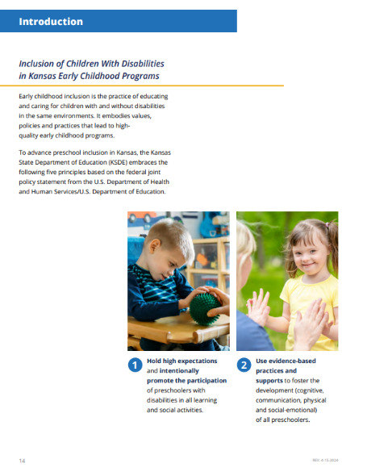

Kansas Early Learning Standards
Updates adopted in 2014.
“Introduction” section includes information on promoting high-quality programming in the least restrictive environment and inclusion of children with disabilities (pages 12-15).
Visit kels.ksde.gov for resources.
Notes:
Natalie

Slide 37
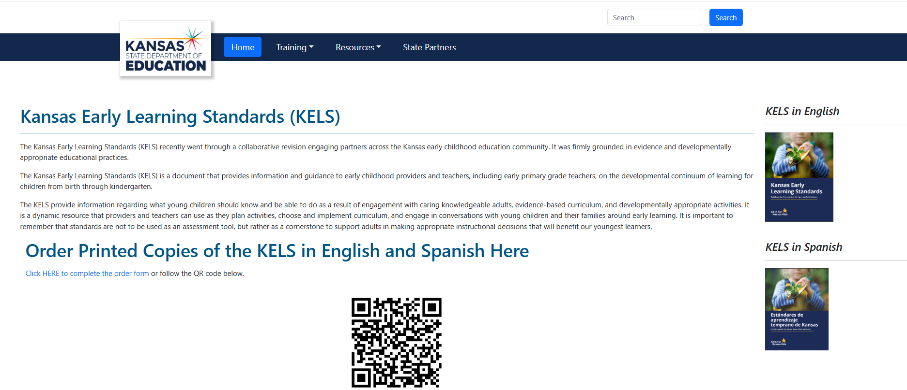
Tools you can use!
Kansas Early Learning Standards and Website

Slide 38
Contact Information
Amanda Petersen Director Early Childhood amanda.petersen@ksde.gov

